Slide 1
Hygienic Stand
April, 15th, 2020

Slide 2
HL Display Hygienic Stand
This Hygienic Stand provides shoppers at the store entrance with a sanitizer holder (two versions available), disposable gloves holder, tissue holder, paper towel holder, mask dispenser and waste bin to increase the safety of your customers.
All the mentioned accessories can be mounted to this stand and are fully customizable due to the needs of each company. The accessories can also be mounted on at any height. Two Sizes available – tall and short.
Hygienic Stand DOES NOT INCLUDE SANITIZER LIQUID
Any RAL color possible (list of RAL colors pls see later)
Material: powder coated steel, PET
Dimensions TALL Version:
1600 (excl. PVC Info Holder on top) x 400 x 400 mm
Dimensions SHORT Version:
800 x 400 x 400 mm

Slide 3
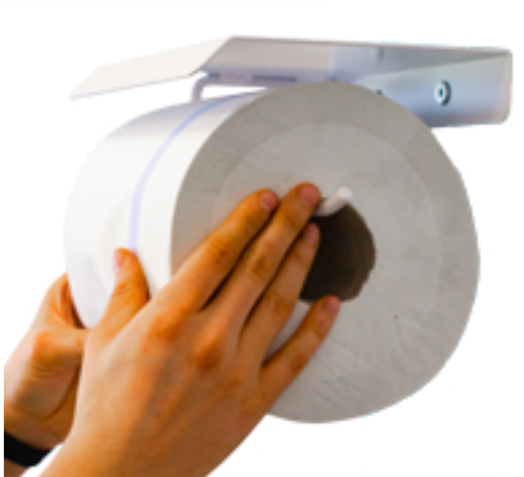
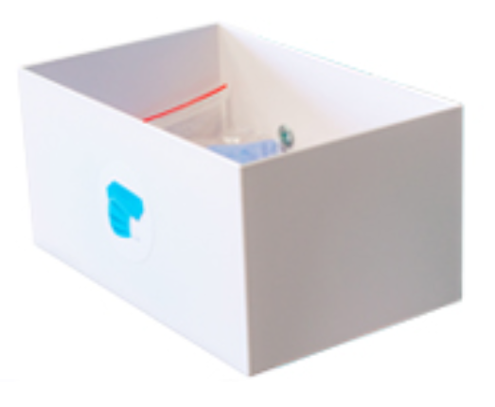
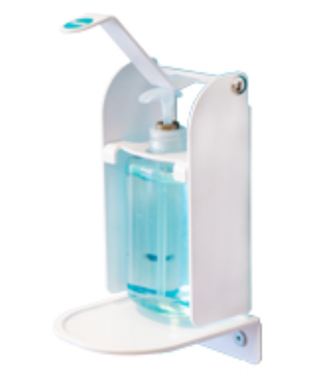
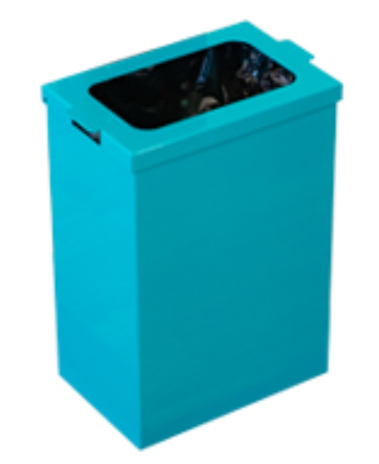
Accessoires
PVC Info Holder (Printed Inlay “Hygienic Point“ not included)
Tissue/Gloves Holder (tissues/Gloves not included)
Paper Towel Holder (Paper Towel not included)
Protective Mask Holder (Masks not included)
Frame SHORT
Frame TALL
Disinfection fluid distributor SMART incl. Sample Bottle (Sanitizer liquid not included)
Disinfection fluid distributor “Z” incl. Sample Bottle (Sanitizer liquid not included)
Garbage Can

Slide 4
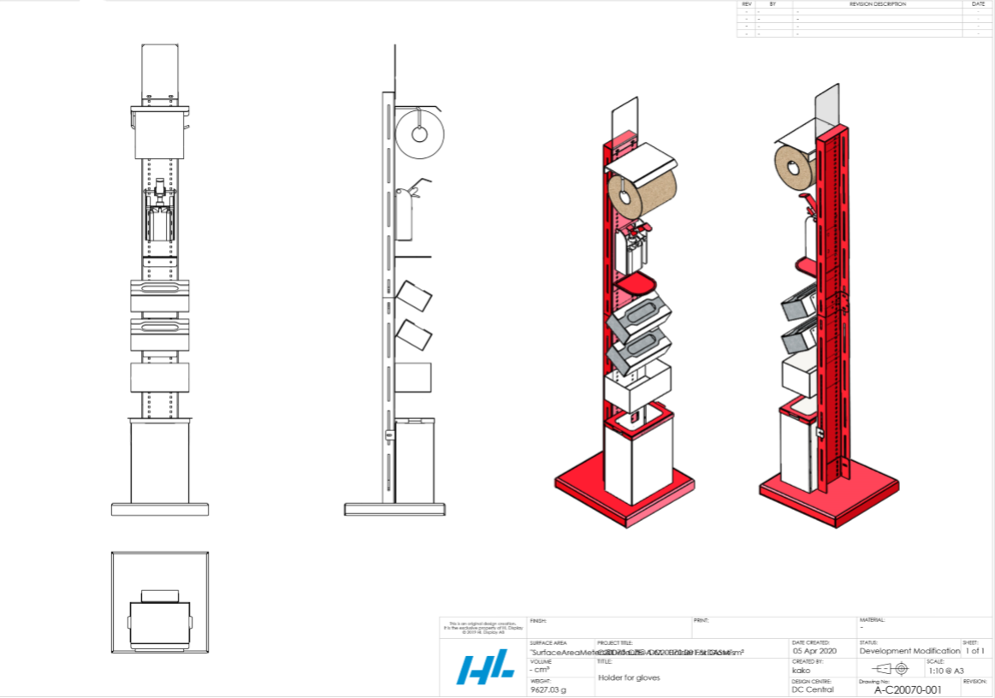
Example 1
Hygienic Stand TALL version with paper towel holder, sanitizer holder, tissue holder, disposable gloves holder, mask dispenser and waste bin

Slide 5
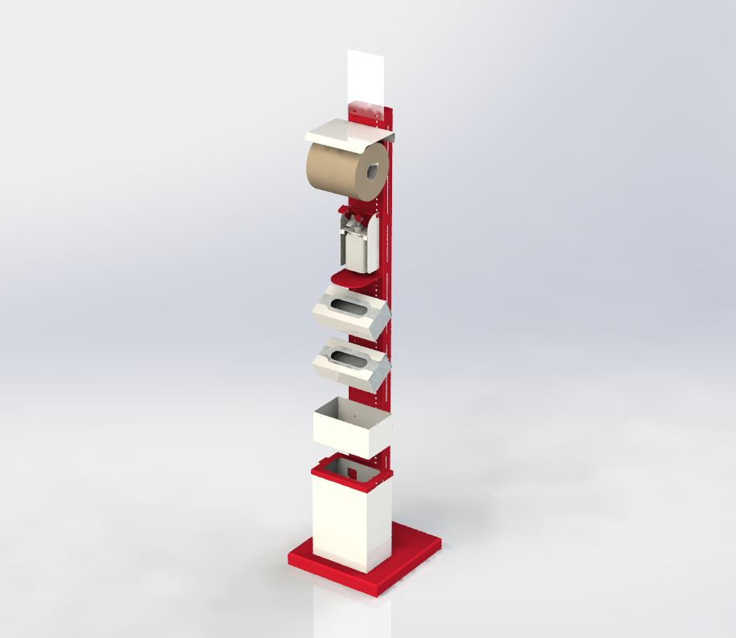
Hygienic Stand TALL version

Slide 6
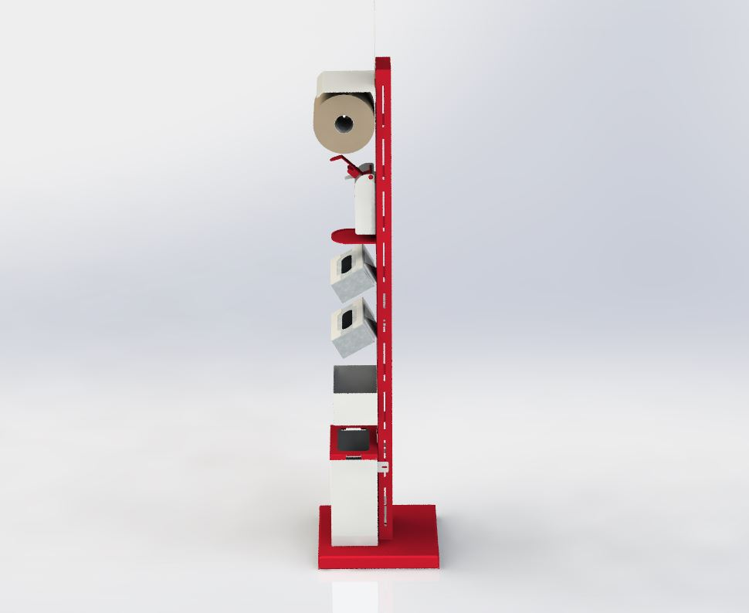
Hygienic Stand TALL version

Slide 7
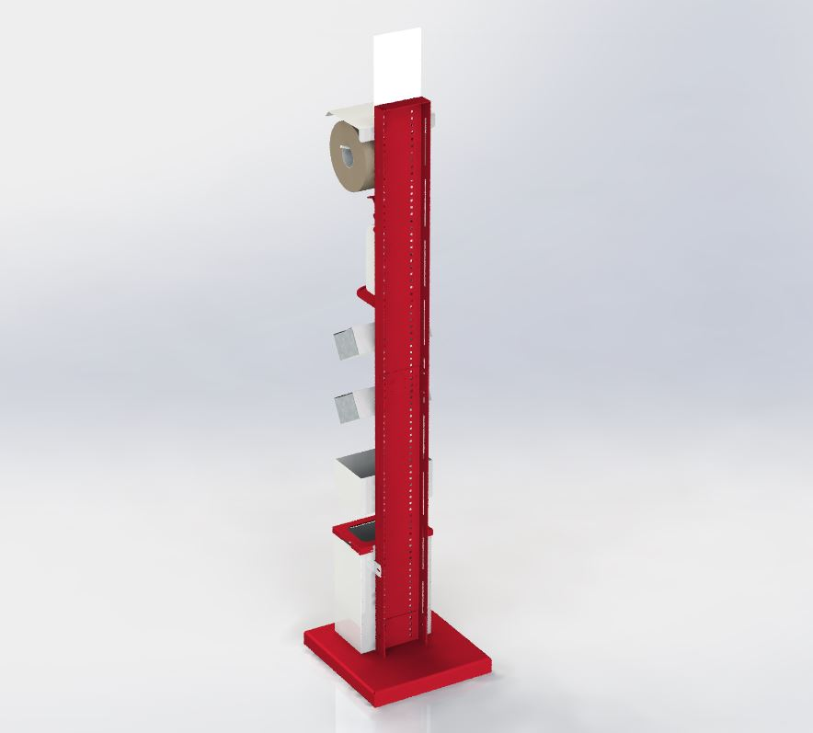
Hygienic Stand TALL version

Slide 8
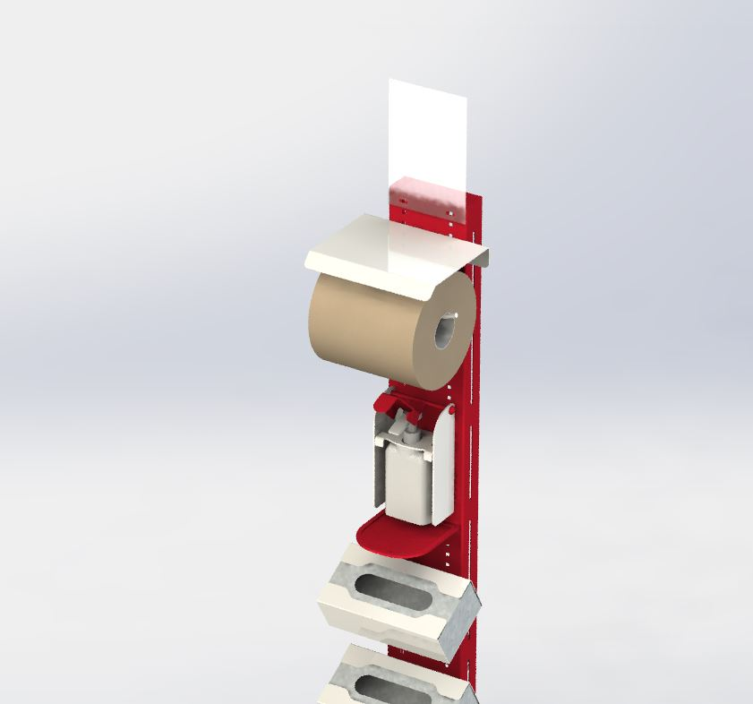
Hygienic Stand TALL version

Slide 9
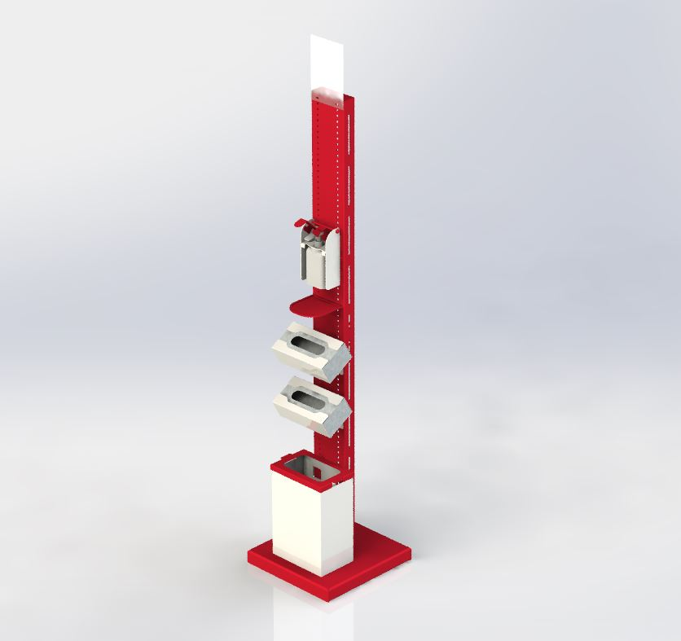
Hygienic Stand TALL version

Slide 10
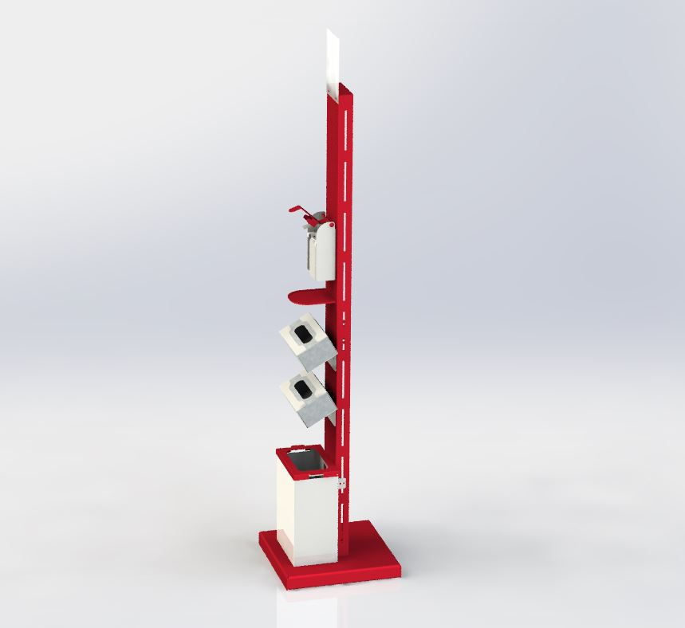
Hygienic Stand TALL version

Slide 11
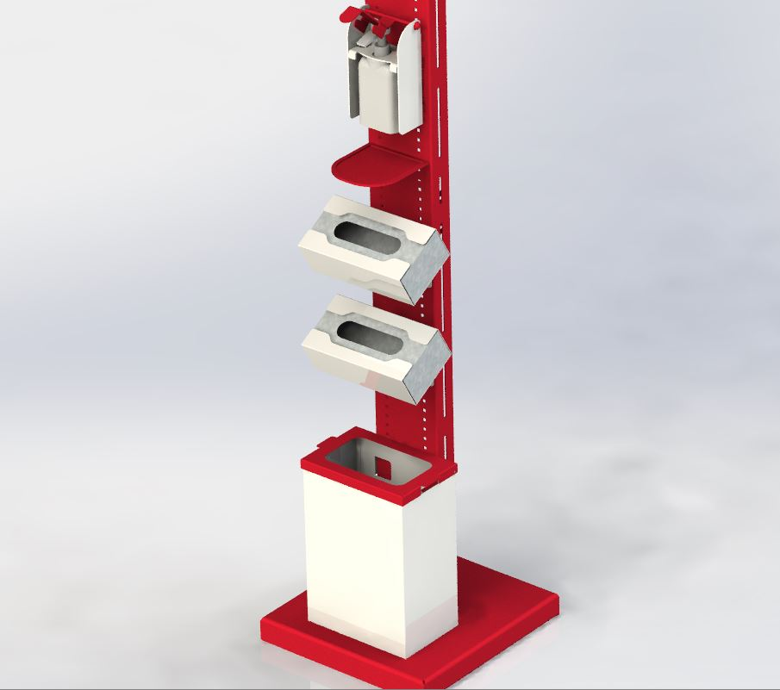
Hygienic Stand TALL version

Slide 12
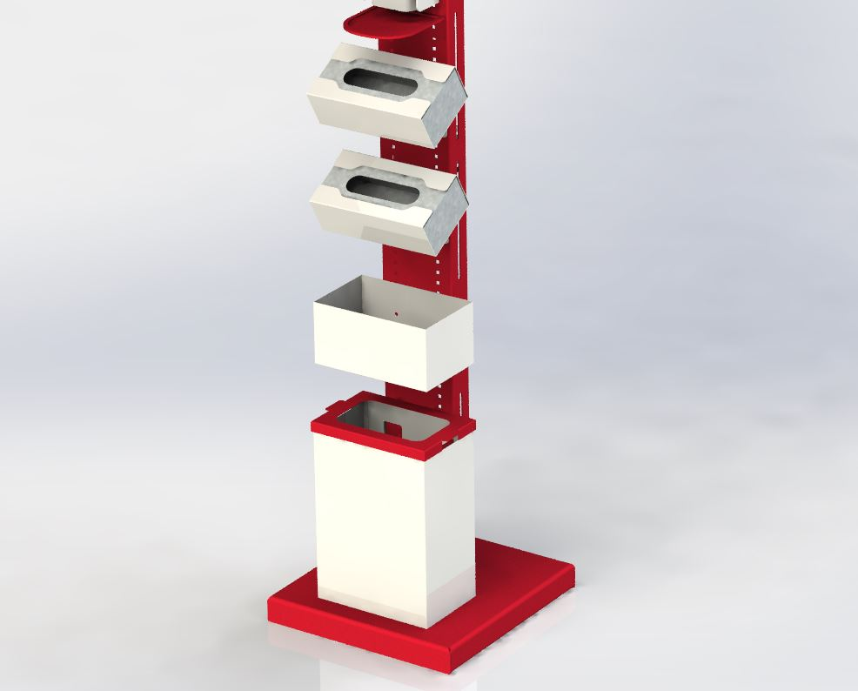
Hygienic Stand TALL version

Slide 13
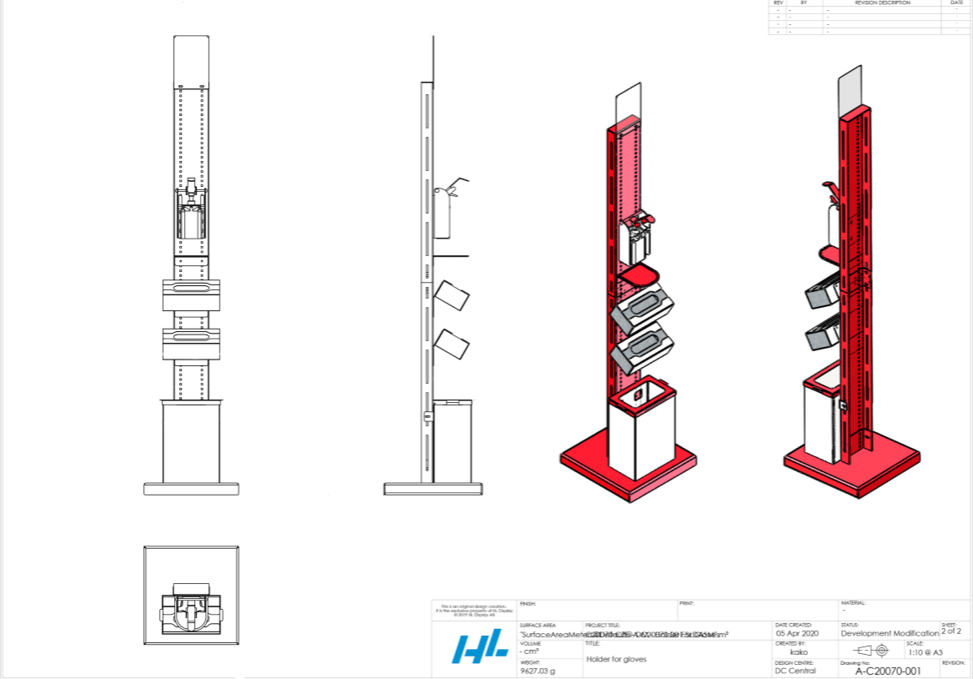
Example 2
Hygienic Stand TALL version with sanitizer holder, tissue holder, disposable gloves holder and waste bin

Slide 14
Hygienic Stand SHORT version

Slide 15
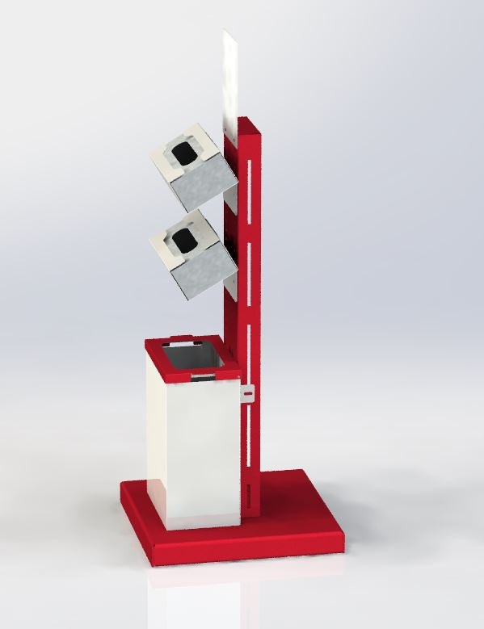
Hygienic Stand SHORT version

Slide 16
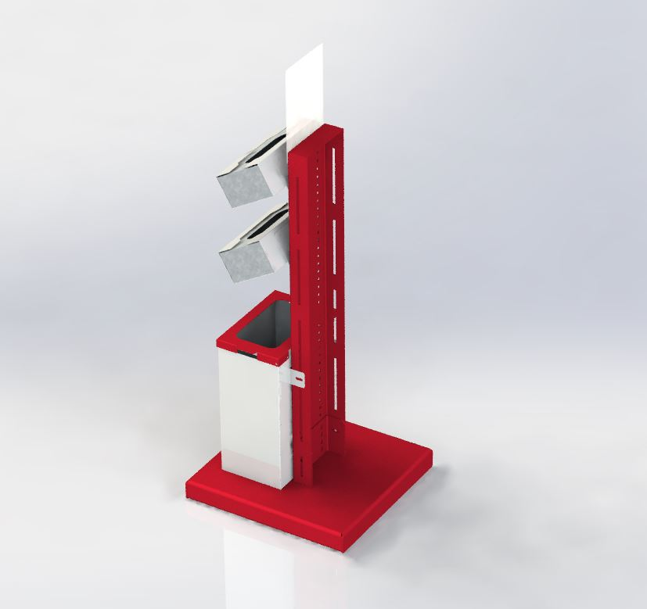
Hygienic Stand SHORT version

Slide 17
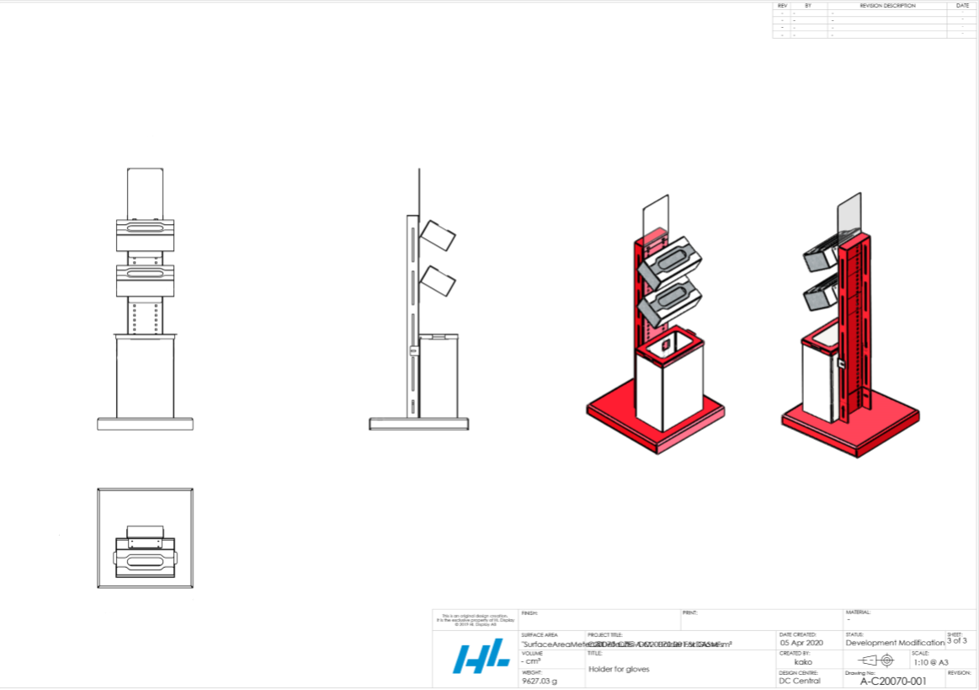
Example 3
Hygienic Stand SHORT version with tissue holder, disposable gloves holder and waste bin

Slide 18
RAL Colors
Here is the list of basic RALs, which are on stock all the time. If you require a RAL-color outside the list, please get in touch with your responsible HL Display Key Account Manager.

