Slide 1
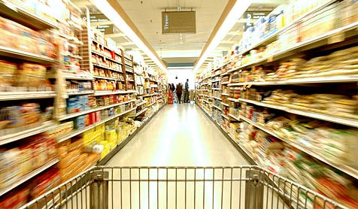
Keeping Pace with Retail Evolution –
Five C’s On the Move
Presented by:
Ray Gaul
Vice President – Kantar Retail
April 2017

Slide 2


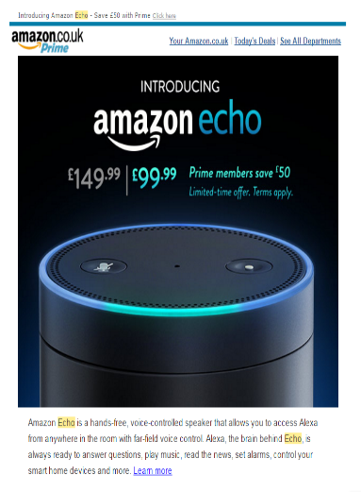
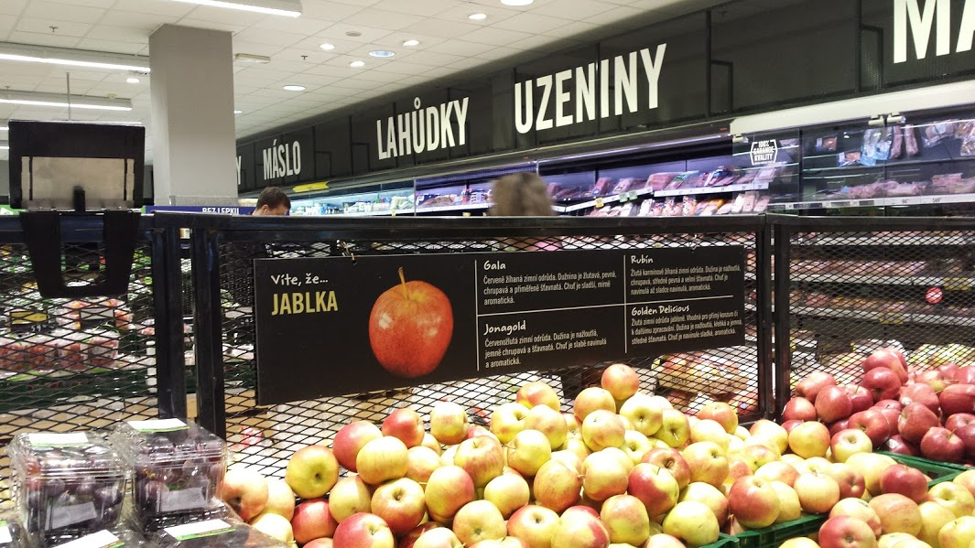
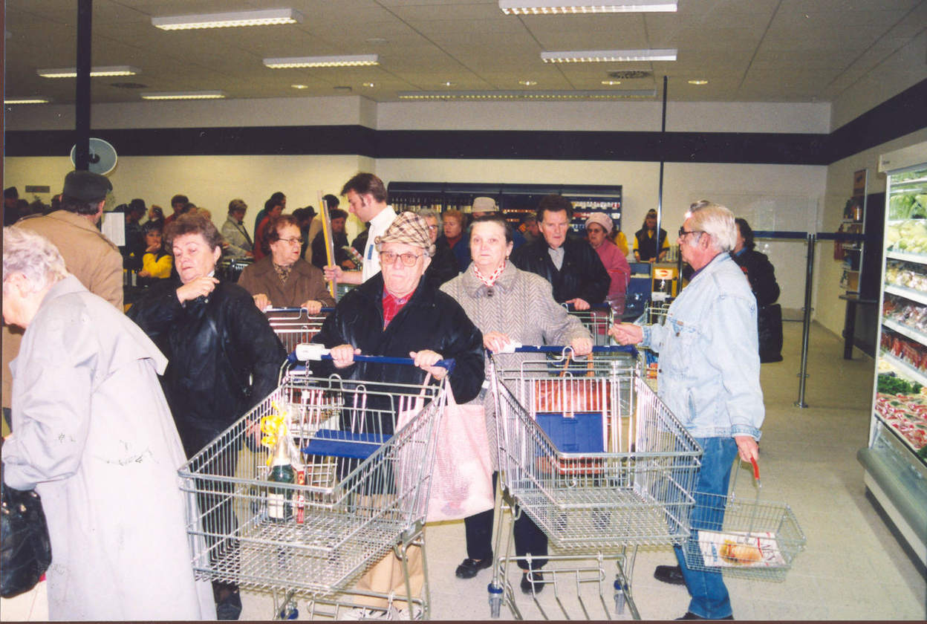
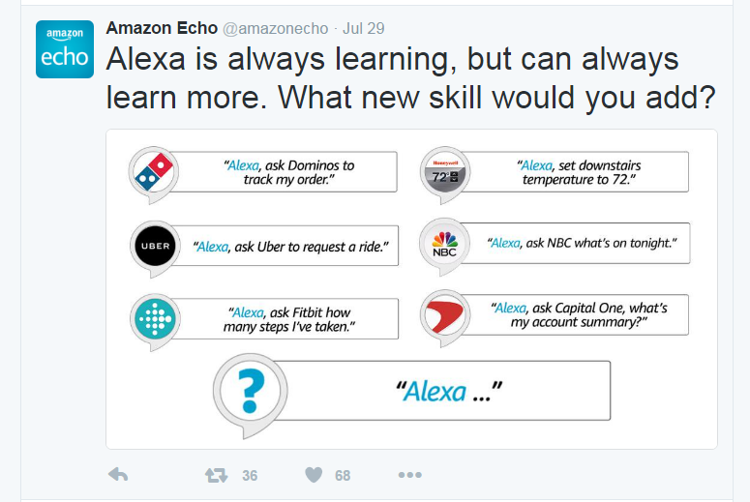



The Future of Retail: 5Cs On-The-Move
All of the 5C Elements in Retailing are in a State of Rapid Transformation – Have we Ever Seen That Before?
C
1. Country (Politics & Economics)
(Political Extremism; Growing Have / Have Not Divide; Changing Role of Regulation – Death of Eurocentrism)
The Past
The Present
The Future
C
2. Consumer (Shoppers & Missions)
(Emergence of Multi-Ethnic & ‘Phygital’ Consumer, Unending Quest for Value, Growing H&W Realization)
C
3. Channel (Format & Store Design)
(Channel Blurring; New Routes to Consumer such as D2C; Continuous Format Reconfiguration)
C
4. Customer (Retailer & Profits)
(Consolidation of Buying Power; Trade Sophistication; Scale ≠ Growth Customers)
C
5. Category (Products & Services)
(Category RESET; Reallocation of Space to Hero Categories, EDLP+; Different Commercial Expectations)
Source: Kantar Retail analysis

Slide 3
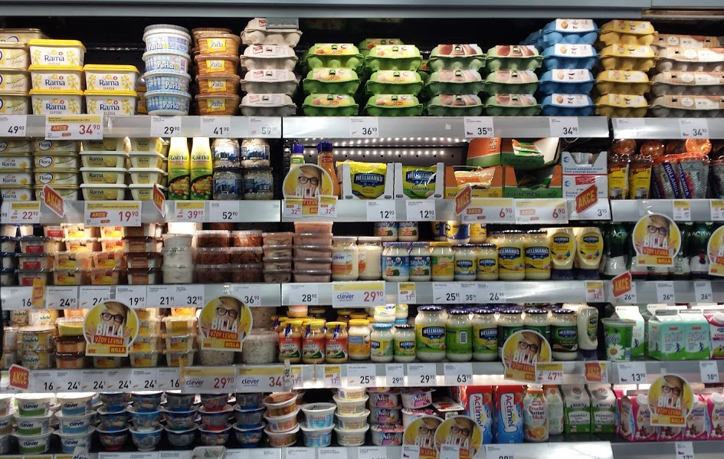

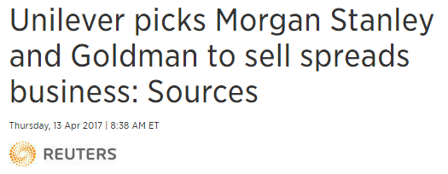
The 5th C: Category
Category Leadership Under Pressure for the First Time in FMCG Retail History
Retailers identified the following as key strengths
Among Kantar Retail’s Top 10 PoweRanking® manufacturers:
How Do You Make a Category Come to Life?
 |  | 2015
 |  | Score %
Procter & Gamble |  | 33.3%
Unilever |  | 21.8%
Coca-Cola |  | 11.5%
Wyeth |  | 8.2%
Mars |  | 6.9%
Nestlé |  | 6.8%
Mondelēz |  | 6.1%
Yili |  | 5.4%
L'Oreal |  | 4.6%
Pepsico |  | 4.4%
KEY STRENGTHS
New product innovation; Great brand awareness
Professional sales team; Deep consumer understanding
Omni-channel marketing approach
Famous consumer brand; High profitability
Category management; Shopper marketing
Clear company strategy
Collaborative customer team
Accurate brand positioning; Marketing approach
Recognizable brands
Objective market analysis and category data
Source: 2015 PoweRanking® China Survey

Slide 4

A Look Back at the Internationalization of European Retail: 1997
How did Modern Trade Hypermarkets Think About Growing in Europe?
Carrefour & Promodes
Number of Hypers by Country
Property Teams Core KPI: R&R
Reachable: 1997 Definition
  How many consumers will be able to reach my hypermarket by car?
    Roads (Generally big motorway locations)
    Car ownership
    Population Density (General focus on cities >50,000 population)
Relevant: 1997 Definition
  How many young families can afford to buy packaged goods on a weekly or monthly weekend stock-up pattern?
    A2 B1 B2 C2 focus
    Household Size of 4+ focus

Slide 5
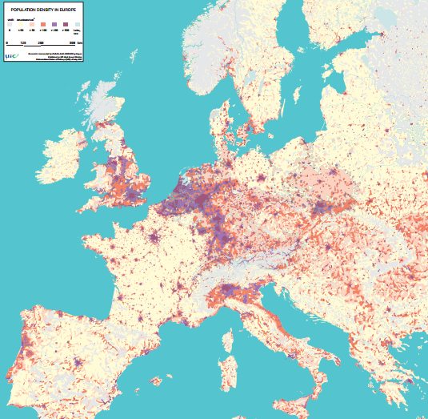
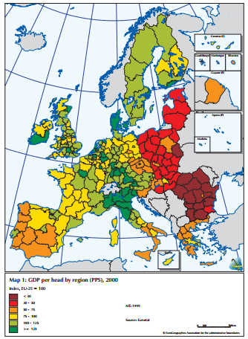
The Result: The Modern Trade Map of Europe in 1997
Reachable: Where the Big Retailers Generate EBIT + Relevant: Where they Expand
The R&R Formula in 1997:
Produced globalization of big box retail from 1970s to 2000s
Created companies that were very good at a 3 step process which allowed them to expand into multichannel grocery operations
  Step 1: Build a Distribution Hub (Cross-Docking with Private Label and Big Supplier Partners)
  Step 2: Train staff and create great in-store execution
  Step 3: Build more stores in the image of the old stores
Tesco
Ahold
Auchan
Metro
Carrefour
Promodes

Slide 6
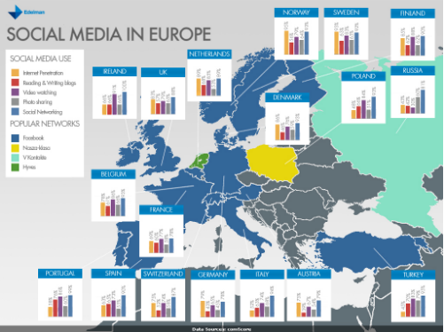
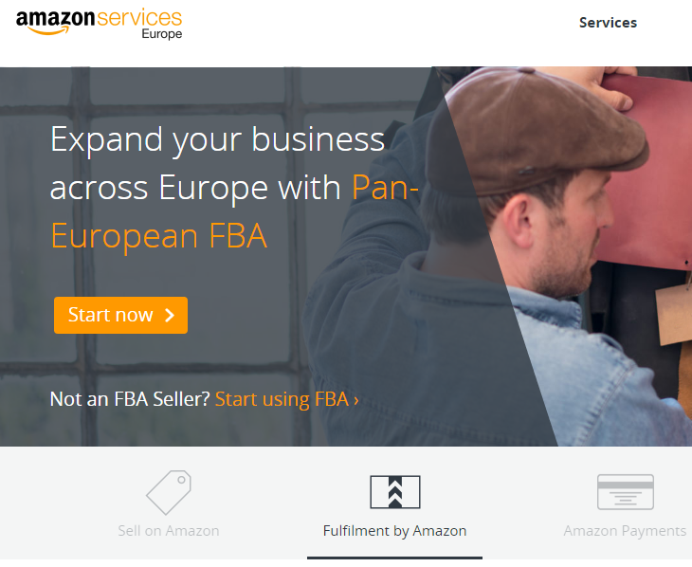
A Look Forward to the Internationalization of Retail in Europe: 2017
How do eCommerce Retailers Think About Growing in Europe?
Fulfillment Teams Core KPI: Social Reach & Family Lifestyle Relevance
Socially Reachable: 2017 Definition
  How many consumers can we reach through different types of technology?
    Mobile phones-apps, tablets, entertainment devices
    “Buy” button functionality
    Fulfillment type via partner (ie, DHL, InPost lockers, etc.)
Family Lifestyle Relevance: 2017 Definition
  How many people can I reach through gifting versus routine?
    Gifting: Entertainment, Restaurant, Apparel, Technology focus
    Routine: Millenials focus + niche collectors and focus groups

Slide 7
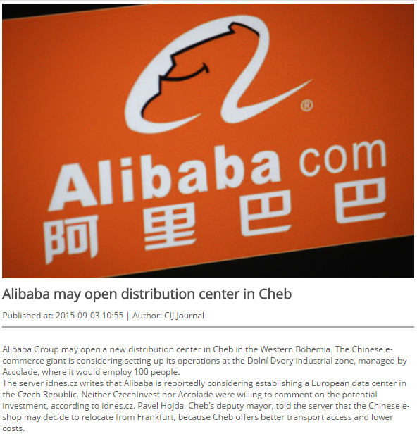
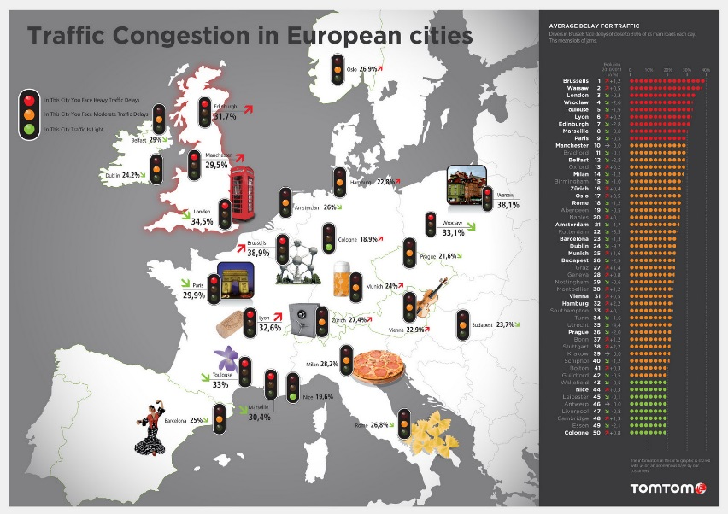
The Result: The Modern Trade Map of Europe in 2017
eReachable: Pan-European Shipping Partnerships eRelevant: Local Rapid Fulfillment Networks
The eR&R Formula in 2017:
Produced globalization of eCommerce retail from 2010+
Created companies that were very good at a 4 step process which allowed them to expand every household
  Step 1: Gift items / Gift Events (Like Black Friday or Singles Day 11.11)
  Step 2: Offer a localized service or focused service (Like Prime Now or AliExpress B2B)
  Step 3: Expand the service using partners
  Step 4: Move to more cities
Amazon Prime Now Cities
Amazon Pan-Europe FBA Warehouses (2018E)
Alibaba Pan-Europe Aliexpress Warehouses (2018E)
20
1
3
2
1
1
1
1
2
Catchment Area Focus

Slide 8
Four Discussion Areas
Thinking about how to win a complex 5C environment
Megatrends for Consumers
Politics: Back to extremism rather than centralism
Economics: Return of inflation
Demographics: Heterogenous is back goodbye middle class homogenous consumption
Urban: Population overload and population decline – urban v rural
Phygital & Ownership: The death of assets (the gig economy, generation rent, etc), the rise of unpredictable shopping
Megatrends for Retailers
Profitability: Retailers selling B2B services, exiting businesses, focusing on supply-chain
Buying Power: Rise of global retailer purchasing alliances
Agile Retailing: Move to agile and local retail
Partnering: Alliances and supply-chain partnerships
AI / Robots: Move to new tech in retail
Changes in Suppliers
Channels: Managing channel blurring
Placement: Understanding how stores change with Phygital shoppers and new services
Space: Doing more with less space
Communication: Aligning to shopper objectives and not consumer/brand
SPEED & Forecasting. Fast and ‘good enough’ rather than slow and ‘perfect’
Winning in Central Europe / CZ
Pricing Corridors: Getting CZ pricing right matters for all of Central Europe and Europe
Discounter Strength: Working against discounters not an option
Demographic/Shopper – high frequency trip missions with Phygital pre-shop: Traffic is the currency of success
Localization: Finding communication that works
Rapid Delivery / Proximity / Ultrafresh: Partnering and agile

Slide 9
Four Discussion Areas
Thinking about how to win a complex 5C environment
Megatrends for Consumers
Politics: Back to extremism rather than centralism
Economics: Return of inflation
Demographics: Heterogenous is back goodbye middle class homogenous consumption
Urban: Population overload and population decline – urban v rural
Phygital & Ownership: The death of assets (the gig economy, generation rent, etc), the rise of unpredictable shopping
Megatrends for Retailers
Profitability: Retailers selling B2B services, exiting businesses, focusing on supply-chain
Buying Power: Rise of global retailer purchasing alliances
Agile Retailing: Move to agile and local retail
Partnering: Alliances and supply-chain partnerships
AI / Robots: Move to new tech in retail
Changes in Suppliers
Channels: Managing channel blurring
Placement: Understanding how stores change with Phygital shoppers and new services
Space: Doing more with less space
Communication: Aligning to shopper objectives and not consumer/brand
SPEED & Forecasting. Fast and ‘good enough’ rather than slow and ‘perfect’
Winning in Central Europe / CZ
Pricing Corridors: Getting CZ pricing right matters for all of Central Europe and Europe
Discounter Strength: Working against discounters not an option
Demographic/Shopper – high frequency trip missions with Phygital pre-shop: Traffic is the currency of success
Localization: Finding communication that works
Rapid Delivery / Proximity / Ultrafresh: Partnering and agile

Slide 10

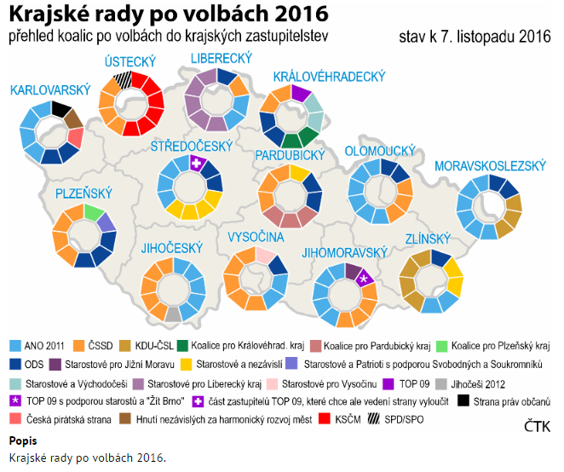


Political Populism
A move away from centralist politics – regional consumer preferences emerging

Slide 11
Inflation is Back
When prices rise, wallet-pinched consumers react in three ways
Buy Fewer Things
Less frequent refills / bulk
Less ‘retailtainment’
Cheaper Store
Avoid stores with wide choice
Pre-shop promotional checks
Cheaper Things
Private label
On promotion
https://www.cnb.cz/en/monetary_policy/inflation_reports/2017/2017_I/zoi_2017_I_charts.html

Slide 12
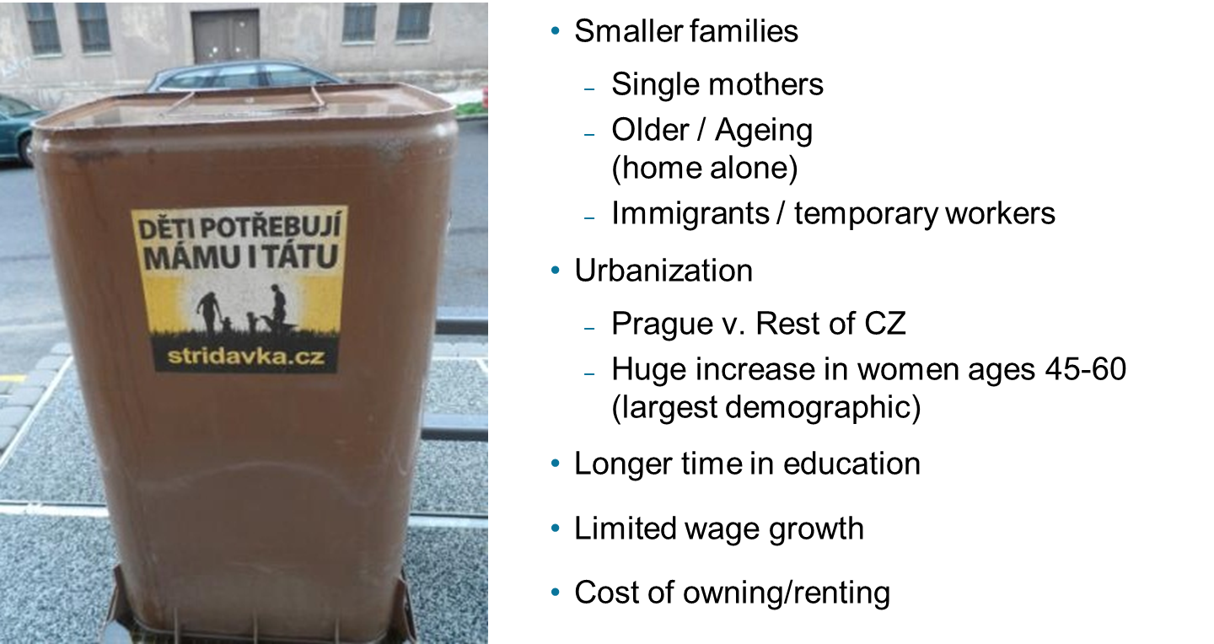
GINI
Pressure on CZ with rising inequality and demographics that favor ‘difficulty’ to earn enough to get by
EUROSTAT

Slide 13

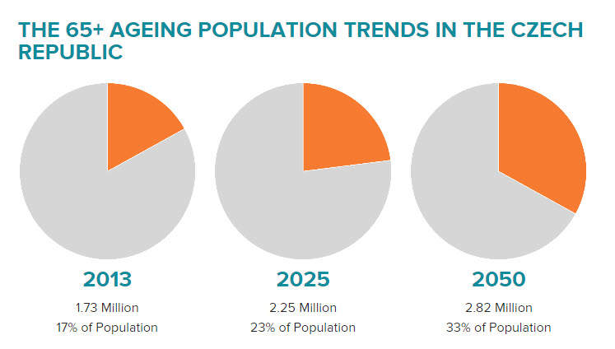
Old & Urban

Slide 14

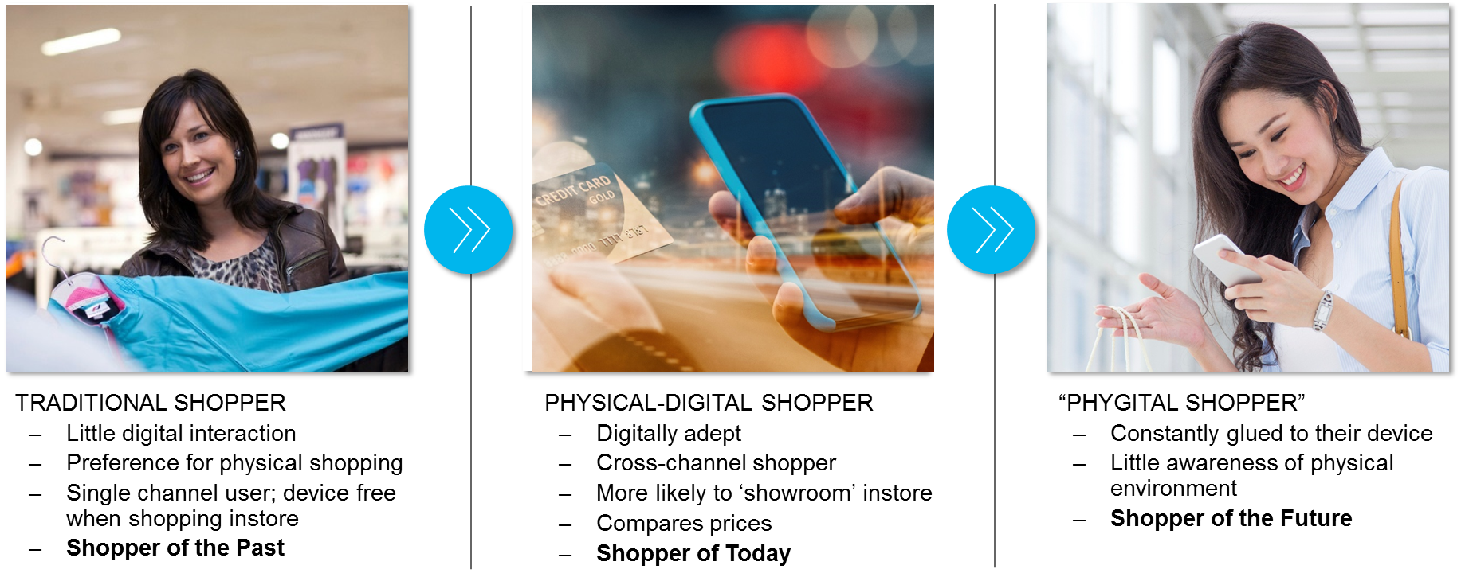
Modern Working / Ownership
The Gig Economy
Mobile Workplace
Generation Rent

Slide 15
Consumer MegaTrends Key Action Points
Consumer
v
Shopper
Science of shopper growing in importance
Consumer profiling less predictable / reliable
Self-Service Shopping v
Assisted Shopping
Growth of assisted shopping / mobile / on-the-go
Self-service environments (ie gondolas) are on decline
Pre-Shop
v
Impulse
Pre-shop must be easy to discover on mobile (no ifs, ands, ors, buts…)
Impulse may increasingly be in unlikely locations (channels)

Slide 16
Four Discussion Areas
Thinking about how to win a complex 5C environment
Megatrends for Consumers
Politics: Back to extremism rather than centralism
Economics: Return of inflation
Demographics: Heterogenous is back goodbye middle class homogenous consumption
Urban: Population overload and population decline – urban v rural
Ownership: The death of assets (the gig economy, generation rent, etc), the rise of unpredictable shopping
Megatrends for Retailers
Profitability: Retailers selling B2B services, exiting businesses, focusing on supply-chain
Buying Power: Rise of global retailer purchasing alliances
Agile Retailing: Move to agile and local retail
Partnering: Alliances and supply-chain partnerships
AI / Robots: Move to new tech in retail
Changes in Suppliers
Channels: Managing channel blurring
Placement: Understanding how stores change with Phygital shoppers and new services
Space: Doing more with less space
Communication: Aligning to shopper objectives and not consumer/brand
SPEED & Forecasting. Fast and ‘good enough’ rather than slow and ‘perfect’
Winning in Central Europe / CZ
Pricing Corridors: Getting CZ pricing right matters for all of Central Europe and Europe
Discounter Strength: Working against discounters not an option
Demographic/Shopper – high frequency trip missions with Phygital pre-shop: Traffic is the currency of success
Localization: Finding communication that works
Rapid Delivery / Proximity / Ultrafresh: Partnering and agile

Slide 17










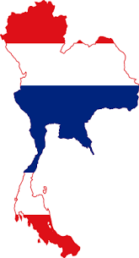





Profitability
Europe’s Leading Retailers Facing Profit Crunch – Results in New Economics
 | Disposal Value/ (Estimates)
 | £4.2 bn
 | £30 mn
 | £25 mn
 | £5 mn
 | £217 mn
 | N/A
 | ~ £1.5-£2 bn **
 | ~ £2.8-£3.2 bn **
 | ~ £1.5-£2 bn **
** Possible sales
Source: Tesco Plc.

Slide 18

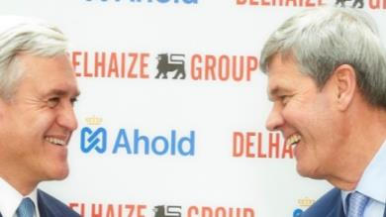
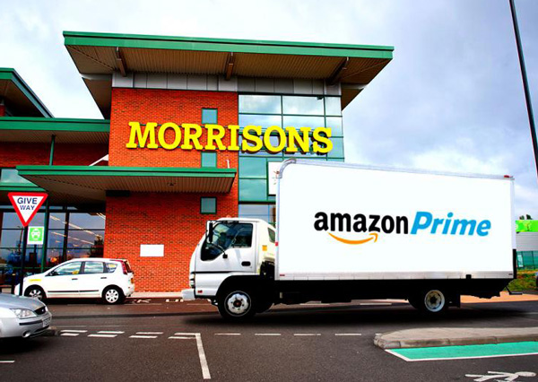


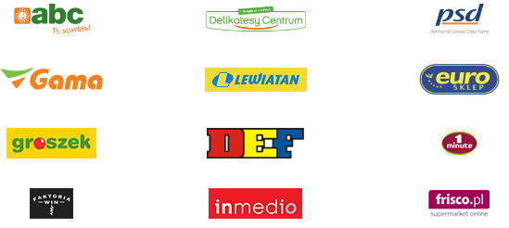


Buying Power via M&A, Franchising, Buying Alliances
Challenges Range from Tougher Negotiations & Pricing Exposure, To Need of Ramping-up Internal Competencies
CONSOLIDATION of TRADITIONAL TRADE
REGIONAL ALLIANCES and MERGERS
BUYING ALLIANCES
CAPABILITY LED ALLIANCES and M&A
Retailers expand through local or regional M&A to gain scale or remove competition. E.g. Ahold-Delhaize merger (US, EU); Migros acquisition of Kipa (Turkey)
Loose alliances for better procurement. These alliances can further expand to cover strategic partnership around supply chain or format development. E.g. Metro & Auchan
Retailers partner for specific capabilities – such as Online/Digital, or Food Service, or Wholesale capabilities. E.g. Morrisons & Amazon, Tesco & Booker
Local stores enter franchise agreements to maximize their purchasing power. E.g. Symbol groups in central Europe- Eurocash in Poland, CBA in Hunary, Coop, Metro Franchising (Slovakia)
Source: Kantar Retail analysis

Slide 19



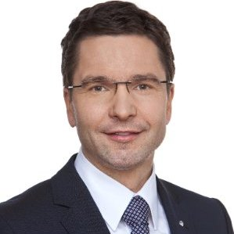

Quiz: What do These Middle Aged White Men Have Share in Common?
Hint: I already told you they are men and middle-aged…
Markus Kaser
CEO Intespar International
Sold Interspar CZ to Albert in 2014
Jose Luis Durant
Ex-CEO Carrefour
Traded Carrefour CZ for Tesco stores in Taiwan, 2005-06
David Morris
Ex-CEO Tesco CZ
Merged Tesco Central Europe, 2015-16
Replaced by Matt Simister in April 2017
Christian Karnath
Ex-CEO Kaufland CZ, Replaced by Andrzej Urbanczyk in April 2017
Jan van Dam
Ex-CEO Albert CZ
Replaced by Jesper Lauridsen in 2013

Slide 20
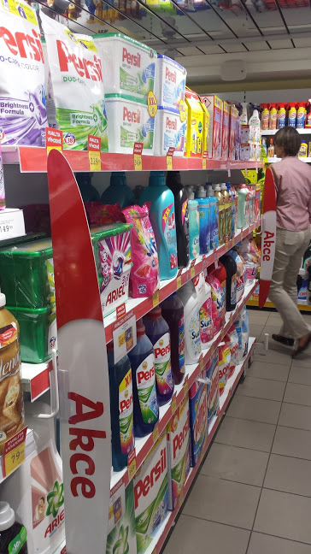
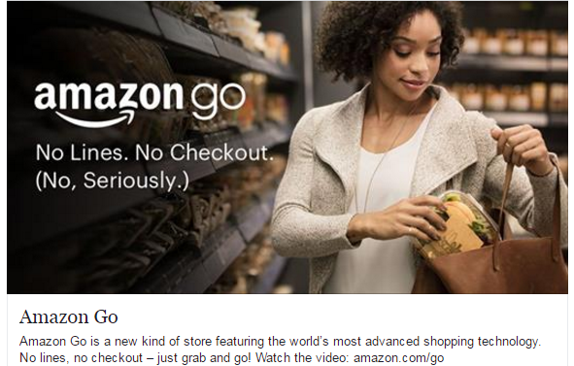
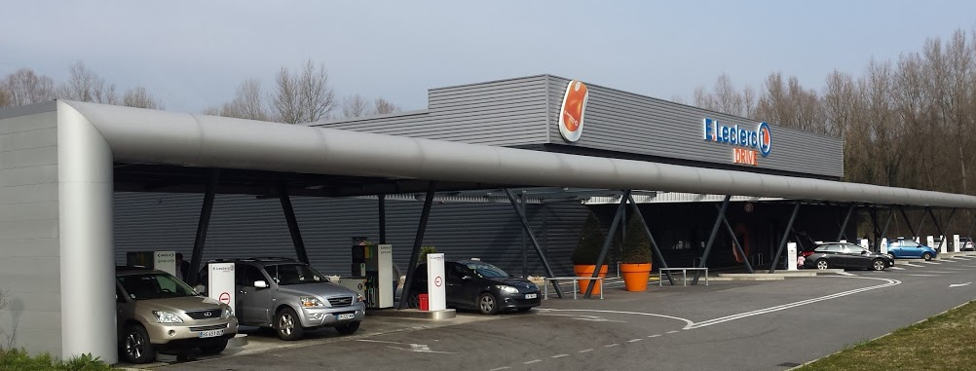
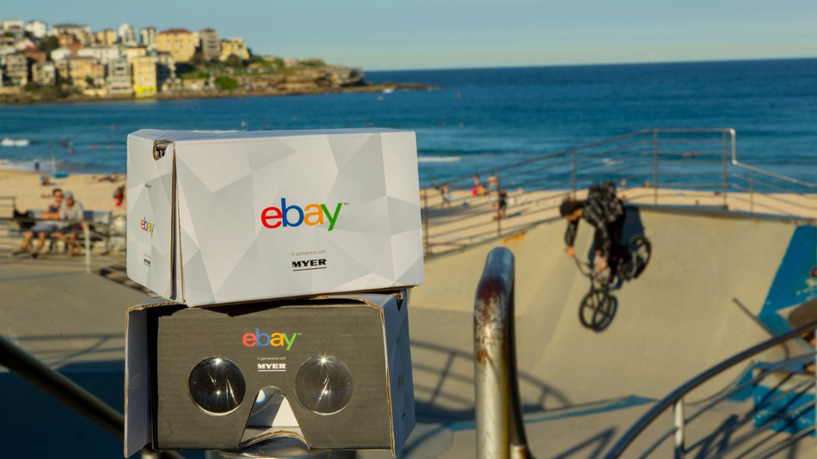
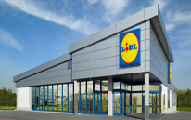
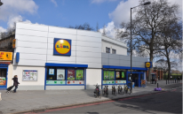
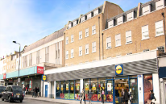
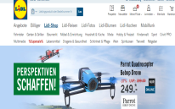
Agile Sizing
Opportunities and Challenges Arise as Channels Venture into Unchartered Territories…
Amazon Go (USA)
Leclerc Drive (France)
Lidl – Soon to be Everywhere
Out of
Town
Edge of
Town
Myer Virtual Reality Department Store (Ebay) - Australia
Family Savings Packs
Drugstore- CZ
In
Town
Online
Watch the Videos: https://youtu.be/yAuiXhJPnr8, https://www.youtube.com/watch?v=NrmMk1Myrxc, https://www.youtube.com/watch?v=CtBTLo7Pc1s
Notes:
Commercial n operational model changes – Biedronka example

Slide 21
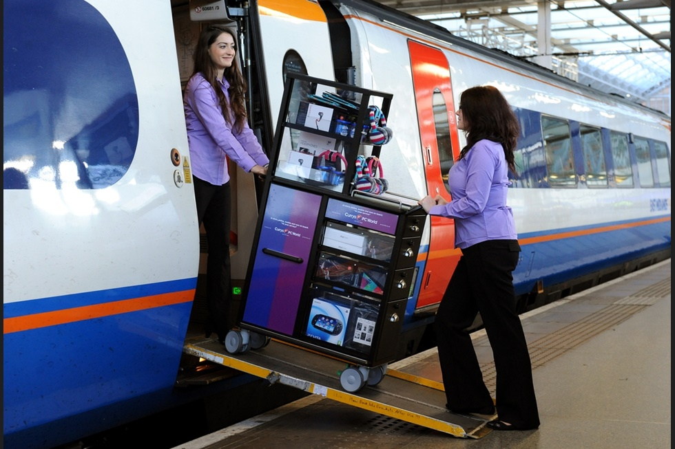







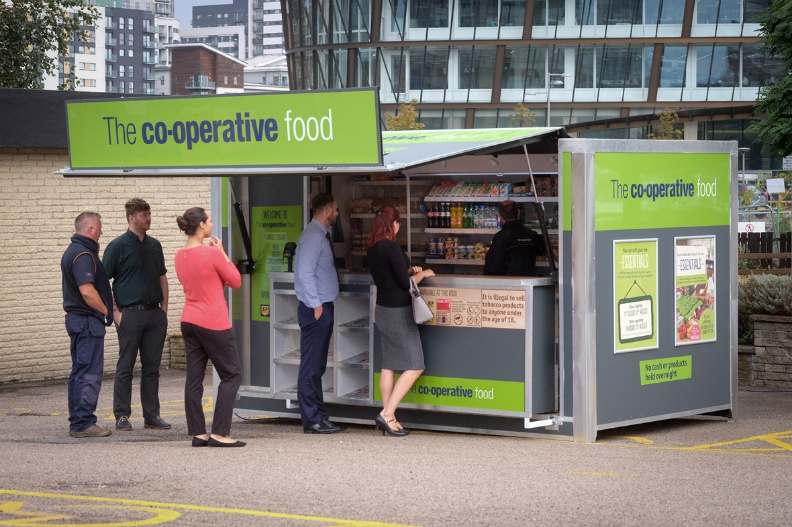










Partnering / Localizing
Challenges around Assortment, Incidence of Purchase, Supply Chain, Theft,
+
+

Slide 22

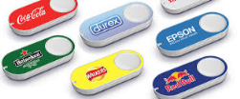


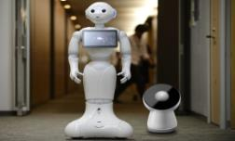
Artificial Intelligence Getting Truly Embedded into the eCommerce Journey – From Basic Algorithms to More Sophisticated Auto-Replenishment
Subscription
management
Today
1-touch
ordering
No-touch
ordering
Integrated
replenishment
Predictive replenishment
Tomorrow
Notes:
Shoppers willing to give up non-experience products to auto-replenishment

Slide 23
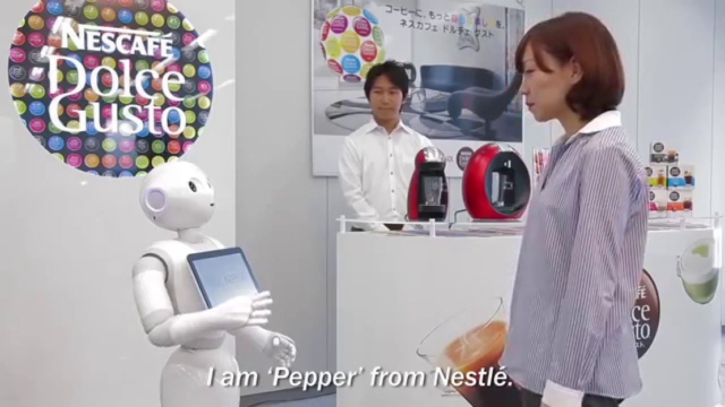
The Rise of Artificial Intelligence (AI)
AI Could Change Retail by Revolutionizing Personalization and Customer Service
The singularity is the hypothesis that the invention of artificial superintelligence will abruptly trigger runaway technological growth, resulting in unfathomable changes to human civilization.
By 2020 85% of customer interactions in retail will be managed by artificial intelligence
70% of US millennials and 62% of millennials in the UK say they would appreciate a brand or retailer using AI technology to show more interesting products.
Source: Gartner, Business Insider
Notes:
Very.co.uk can create 1.2 million versions of its homepage, with flexible elements including the type of promotional messages and their position on the page.
The retailer has also begun personalising search results so that shoppers looking for a particular item will see the brands and styles they like listed first.

Slide 24





METRO AG: WHAT THE FUTURE LOOKS LIKE
4 Divisions / Focus Areas
Metro AG
WFS
Sales
Wholesale
Foodservice
Delivery (FSD)
WFS
Support
Accelerator & Digital
1. HORECA
2. Traders
3. SCOsª
4. Premium FS
Real
Key Personalities and new areas of focus
Title | New Area of Focus | Prior Role
CEO- Olaf Koch | Acquisitions in premium foods (FSD) | CEO Metro Group (focus on re-energizing non-food)
CFO- Christian Baier | Cash flows and inventory speed | CFO Metro Group (focus on disposals & profits)
COO- Pieter Boone | Trader services & Franchise program (increasing number of loyal customers) | CEO MCC (focus on LFL sales performance)
Operating Partner- Philippe Palazzi | CEO for HORECA with country focus on France, Spain, & Portugal | CEO MCC Italy (focus on Ultrafresh)
a. SCO focus will look at countries where there is growth in this group and will be localized

Slide 25
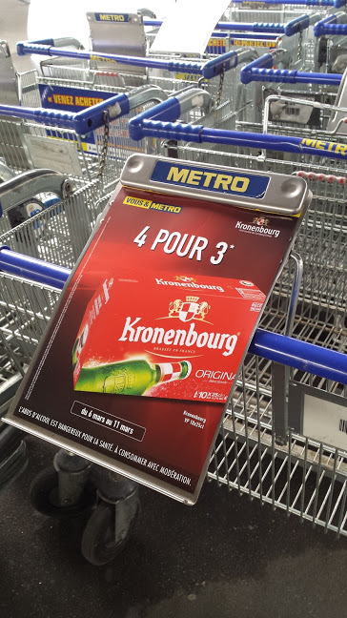
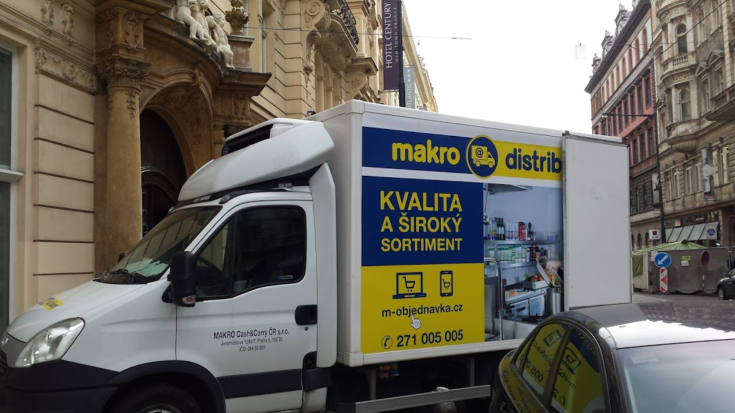
METRO AG: The Math
What will make Metro WFS Happy?
Component | Metro’s Expectation | 2016 Corporate Value | 2017 Expectation | What it means for suppliers
Sales | Limited topline growth for traditional sales clients but growth via switch to FSD and Delivery | EUR29.0 billion (-2.3%) | >29.8 billion (growth of 3% - note first year of growth in some time) | General selling stories not the first thing they want to hear from you – should focus on target audience
Margin (Now called total cost ratio) | Reduce low turn items in favor of FSD items, improve cost of delivery | GM: 19.0% (up from 18.9%) Other income via partners -5.1% (up from -4.9%) leaving TCR of 13.9% (down from 14.0%) | GM will migrate north due to switch to fresh and premium BUT other income must hold at 5.0% which will give TCR of 14.0% or better | They don’t even talk about margin at investor meetings now this is all about cost to deliver item
Operating Expenses (EBITDA %) | Each country must reduce in multiple areas | 5.0% (up from 4.9%) | Approx 5.0% | Reductions in Head office at each country; more work in the field
CAPEX | Reduce by 10% at country level | 2.1% (down from 2.2%) | 2.0% or lower | Category resets, including equipment, will be cost effective
Net Change in Working Capital (NWC) | Improve versus prior year | -30 (from -47 to -77) | -100 (in line with 2014), improvement of -30 | Payment days focus both on supplier (you) and client (Horeca, SCO, Trader)
Free Cash Flow Conversion Rate | Get to >60% rate through capex and NWC discipline | 53% | 60% (note that in 2014 it was 56%) | Details matter-do it for all countries and show you did it
FCF conversion – before S.I. defined as (EBITDA before special items - capex excluding finance lease extensions and M&A +/- change in NWC)/EBITDA before special items

Slide 26
Retailer MegaTrends Key Action Points
Margin
v
Profit
Margin is a supplier topic, no longer the main focus of retailers (cashflow & profitable services now key)
Profit & Free Cash Flows Should be Measured when Building Country/Channel/Customer Financials (P&L, etc)
Country Pricing v
Global Pricing
Terms & Turns alignment never more important (TPM work)
Retailers will see more than you think they can, so use the test, “am I OK if they see it?”
Category
v
Experience
Retail is becoming more experiential and on-the-go and less programmatic / self-service
Category as a “map” for the shopper is losing some traction as a result so get good at experience, placement, agile

Slide 27
Four Discussion Areas
Thinking about how to win a complex 5C environment
Megatrends for Consumers
Politics: Back to extremism rather than centralism
Economics: Return of inflation
Demographics: Heterogenous is back goodbye middle class homogenous consumption
Urban: Population overload and population decline – urban v rural
Ownership: The death of assets (the gig economy, generation rent, etc), the rise of unpredictable shopping
Megatrends for Retailers
Profitability: Retailers selling B2B services, exiting businesses, focusing on supply-chain
Buying Power: Rise of global retailer purchasing alliances
Agile Retailing: Move to agile and local retail
Partnering: Alliances and supply-chain partnerships
AI / Robots: Move to new tech in retail
Changes in Suppliers
Channels: Managing channel blurring
Placement: Understanding how stores change with Phygital shoppers and new services
Space: Doing more with less space
Communication: Aligning to shopper objectives and not consumer/brand
SPEED & Forecasting. Fast and ‘good enough’ rather than slow and ‘perfect’
Winning in Central Europe / CZ
Pricing Corridors: Getting CZ pricing right matters for all of Central Europe and Europe
Discounter Strength: Working against discounters not an option
Demographic/Shopper – high frequency trip missions with Phygital pre-shop: Traffic is the currency of success
Localization: Finding communication that works
Rapid Delivery / Proximity / Ultrafresh: Partnering and agile

Slide 28
Channel Blurring: Understanding & Managing Types of Retailer Promotions
Two types – Immediate and Indirect
IMMEDIATE
% off
  Certain period of time (for two weeks ending 1/1)
  At certain time of day (example bread gets discounted after 6pm)
  In certain store areas (such as discount bin or manager specials)
Multibuy (BOGO, etc)
Line Pricing (everything at “10”)
Member Pricing (if you have loyalty you get savings)
  Students, pensioners, credit card holders etc
Flash Sale
Service Bundle (free coffee if you buy more than X)
DEFFERED AND INDIRECT
Loyalty points
Coupons
Competition
Giveaways or Holidays
Price Match (to competitor)
Free Shipping / Free Returns
NON-PRICE
Private Label
Total Basket Comparisons
Exclusives/Unique Events

Slide 29
The Work We Need to Do to Stay Best in Class
Map promotions and stay in front of change
Immediate
&
Visible
10% off
Indirect
&
Visible
Collect 30 bonus points
Less visible
&
Deferred
Save on home delivery for 12 months
Less visible
but
Immediate
Everything for 10
Generally, retailers get suppliers to fund the left side and this is negotiated with the buyer and well planned out in packaged goods
  The right side is often never discussed in either buyer meetings or in JBP
With channel saturation & channel blurring, retailers move more and more promotional funds to the right side – Amazon Prime for example
As digital disruption occurs more and more funds shift to the bottom of the equation
The result is that ‘savings’ are increasingly complicated conversations with shoppers and reflect lifestyle choices rather than product choices

Slide 30
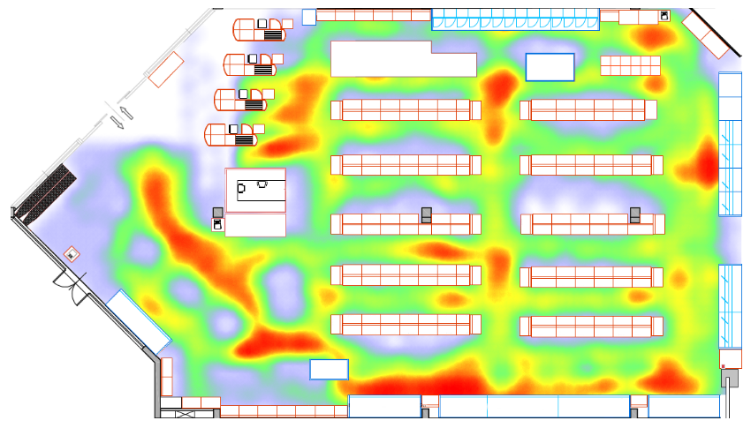
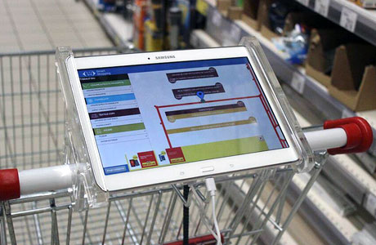
Placement: Changing Category Dynamics – Pressure on All Fronts
Challenges Around Placement – Getting the Right Location Critical for Success
Only 2% of all Shoppers go through the entire store
Have you thought about:
What % of shoppers actually visit your primary location/aisle?
Changing heat map within the store?
Check-out reinvention (self-scan, pay as you go, flex location)
Click & Collect locations (e.g. In-Post lockers)
Source: Kantar Retail analysis

Slide 31
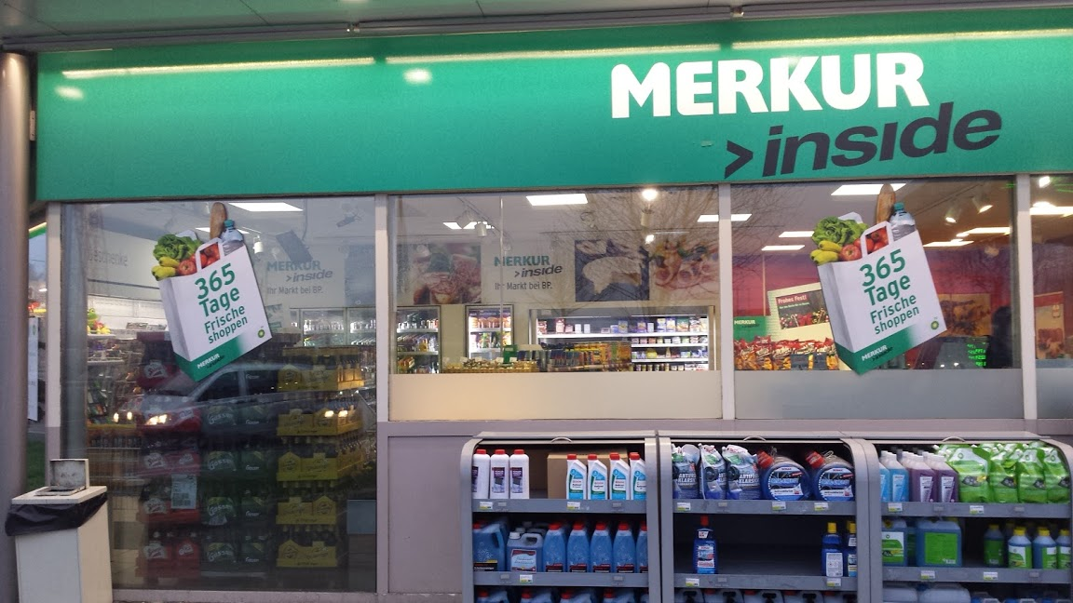
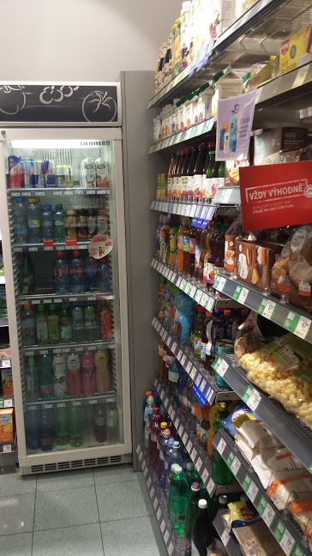
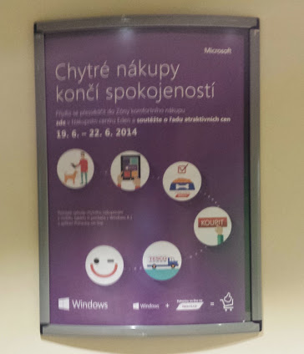
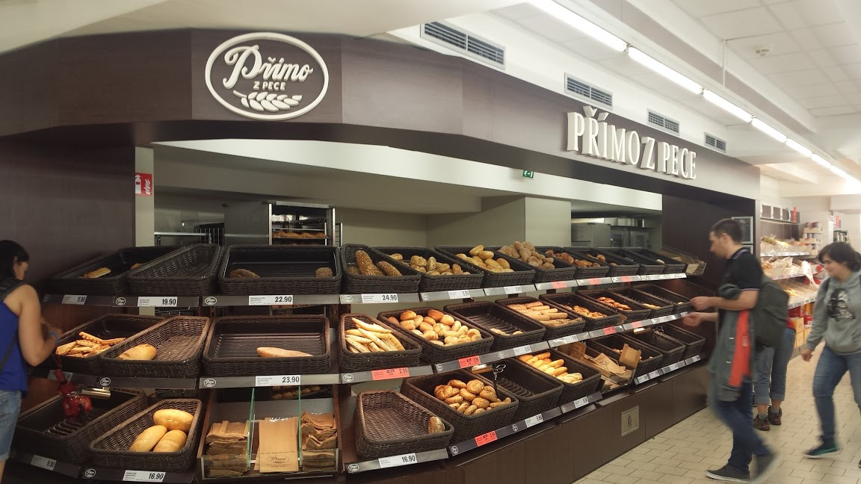
Space: Changing Category Dynamics – Pressure on All Fronts
Petrol stations now want to be your daily grocery destination
(not the place you buy cigarettes)
Reallocation of Space to Hero Categories Results in Store Redesign and ‘Battle for Visibility’
Drug - Beauty / Health Services / Food-to-Go
Grocery & Convenience –
Mobile / Food Service
/ Fresh / Lockers
Discounter – Fresh / Bakery / Beauty
Source: Kantar Retail analysis

Slide 32
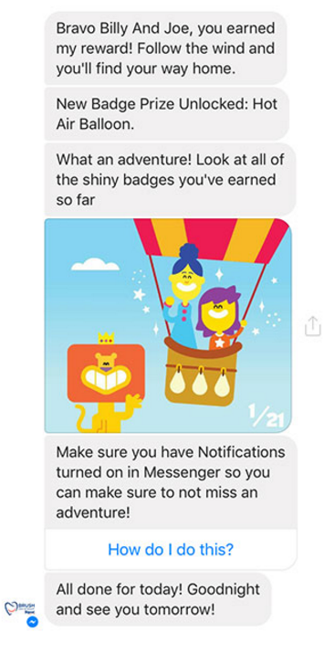

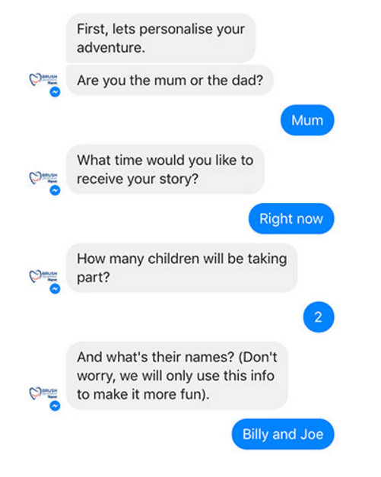



Communication
Case Study – Unilever Using Facebook Messenger to Entice & Influence Spend
Source: Kantar Retail research and analysis, Company website
Notes:
Chat commerce is becoming a new way to buy. Distributed commerce (e.g. buy buttons on Pinterest) continues to capture the imagination, but chat commerce is gaining attention from success stores in Asia (e.g. WeChat), and Facebook pushing it forward with some chatbot enhancements to Messenger earlier this year.
To fully leverage Chatbots, greater attention on improving messaging applications to establish more meaningful connections between the brand and customer is required.
Moving forward, chatbots can be used to help change shopper attitude, behaviour, daily habits, or even help embed products into people’s lives. A great example of this is Unilever.
The chatbot tells a 21-part interactive video story called “The Adventures of Little Brush Big Brush,” which entertains children while teaching them proper brushing techniques and habits.
Where this example shines is in the bot’s interactive engagement that combines rich animation and storytelling, gamification and badges, and social routines for the family.

Slide 33
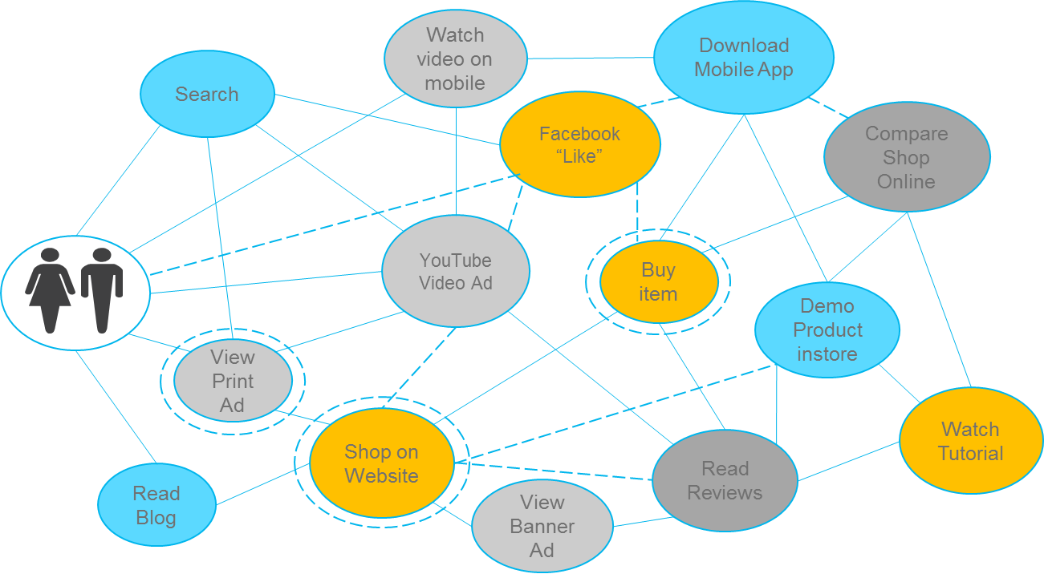
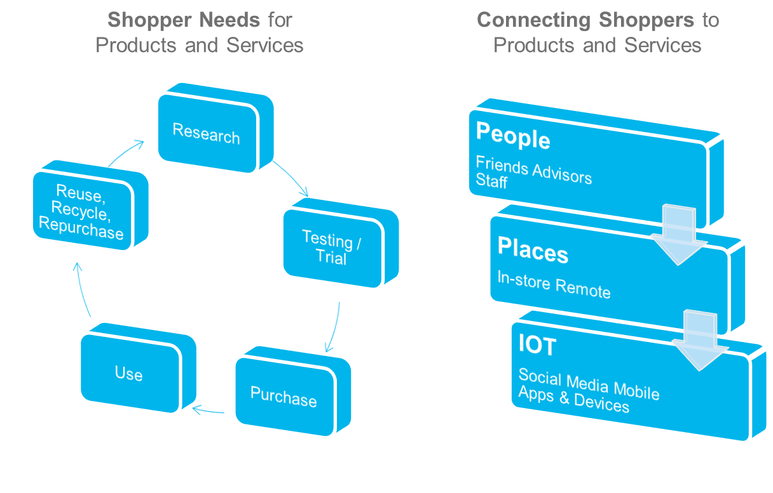
The 2017 Shopper Journey is Complex
Engaging a fast moving target at every touch point is essential to win the shopper
Tech buzzwords like omnichannel, phygital, and no-rooming have no meaning to consumers. It’s just ‘shopping’.
Consumers want help connecting them across the platforms they love.

Slide 34
5 Ways to Create Differentiation
Total Shopper Value Equation
1. Edited Assortment
2. Exclusives
3. Local
4. Loyalty / Reward
5. Targeted (Predictive)
Understand the Retailer
Robust knowledge
Limited knowledge
Limited knowledge
Robust knowledge
Understand the Shopper

Slide 35
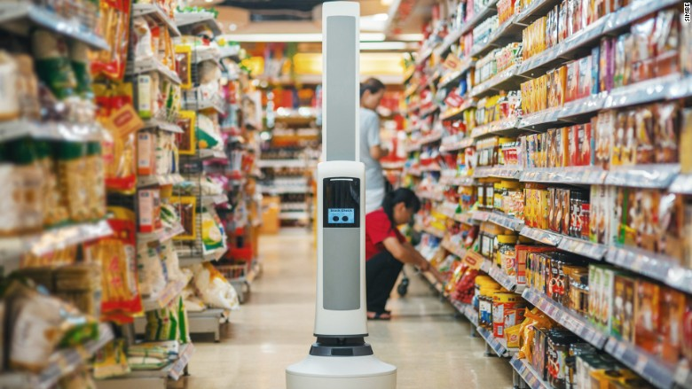
Forecasting / Speed
Case Study – Dairy Supplier Uses AI to Improve Demand Forecasting and Supply Chain Performance
Integrate data sources ranging from – shopper insights, POS data, weather forecasts, historical and current consumption patterns, planned promotional activity or event - to automatically generate real time insights which are shared in a simplistic and actionable manner across the concerned teams
Results:
Increase in forecast accuracy to 92%
Improved service level to 98.6%, with 30% reduction in lost sales
6% increase in net ROI the first year—improved to 8% the next
36% improvement in net uplift from promotions the first year; improved 55% the next
Demand planner workload cut in half, with re-focus on higher value-added activity
Source: Tools Group

Slide 36
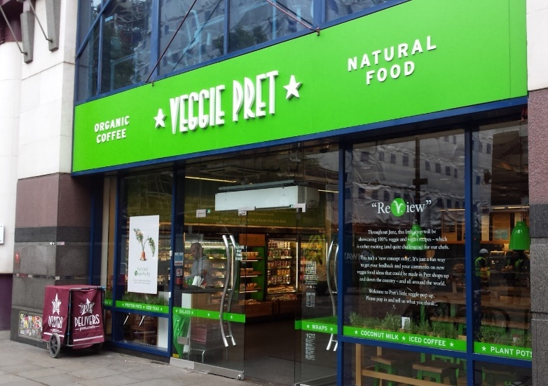
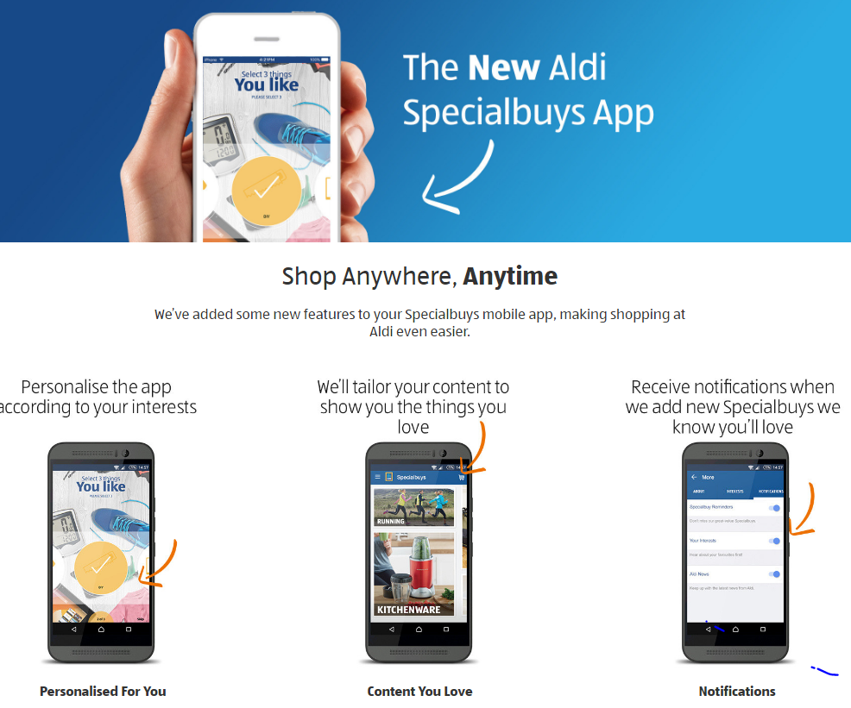
Consumers Demand That Retailers Simplify Confusion
Edited Physical Assortment
Edited Online Assortment

Slide 37
Supplier Changes Key Action Points
Category
v
Store
Categories now less relevant than the service you receive
Marketing
v
Activation
Marketing in classic way is not always enough to get purchase
“Perfect” Store
v
Speed
The idea of a “perfect category” or a “perfect store” become less relevant as rapid/evolving and service based become keys to retail success
Stores now function in new ways so begin to map these and understand traffic/shopper needs
Leverage new ways to activate shoppers along new touchpoints
Build speed into your ethos

Slide 38
Four Discussion Areas
Thinking about how to win a complex 5C environment
Megatrends for Consumers
Politics: Back to extremism rather than centralism
Economics: Return of inflation
Demographics: Heterogenous is back goodbye middle class homogenous consumption
Urban: Population overload and population decline – urban v rural
Phygital & Ownership: The death of assets (the gig economy, generation rent, etc), the rise of unpredictable shopping
Megatrends for Retailers
Profitability: Retailers selling B2B services, exiting businesses, focusing on supply-chain
Buying Power: Rise of global retailer purchasing alliances
Agile Retailing: Move to agile and local retail
Partnering: Alliances and supply-chain partnerships
AI / Robots: Move to new tech in retail
Changes in Suppliers
Channels: Managing channel blurring
Placement: Understanding how stores change with Phygital shoppers and new services
Space: Doing more with less space
Communication: Aligning to shopper objectives and not consumer/brand
SPEED & Forecasting. Fast and ‘good enough’ rather than slow and ‘perfect’
Winning in Central Europe / CZ
Pricing Corridors: Getting CZ pricing right matters for all of Central Europe and Europe
Discounter Strength: Working against discounters not an option
Demographic/Shopper – high frequency trip missions with Phygital pre-shop: Traffic is the currency of success
Localization: Finding communication that works
Rapid Delivery / Proximity / Ultrafresh: Partnering and agile

Slide 39




Czech Republic – Pricing Corridors
Schwarz (Kaufland): Now in AMS
Ahold Delhaize (Albert): In Coopernic and AMS
REWE (Billa & Penny): Working with Coopernic
Tesco: Buying Wholesalers (Booker) merged ops with Cent. Europe
Metro: Working with Auchan:

Slide 40
Channel Dynamics in Europe
Core Hyper-Supers see Limited Growth in WE, Alternative Channels Gaining Share, All Channels Grow in CEE
Source: Kantar Retail 2017 – based on chain retial coverage of all categories including non-food; Kaulfand , Mercadona, and Colruyt placed as discounter

Slide 41







Full Service Grocers on Defensive
Store Downsizing
Closures
Remodels
Bankruptcy
Kaufland + Discounters Creating Headaches as they move to Fresh & Local
IMPACT

Slide 42


Frequency the Key
Price pressure to drive trips

Slide 43






The Battle for Local
Exposed
Less Exposed
Champion
Source: Kantar Retail, Store Visits, Czech Republic, June 2016

Slide 44


On-the-Go Requires Adjustments
Speed to Consumer Matters Most
Location based speed
At my home, work
On my way from, to
Fast to shop
Everything in one go
Collection based speed

Slide 45
To Summarize…
Current retailing environment resembles a ‘5C Transformation – Country, Consumer, Channel, Customer, Category.
Aligning to the new reality
  Phygital
  Agile
Keeping pace with best practices
  How is retail structure, formats, buying power, trade sophistication evolving? What are the resulting implications?
  Think of innovative ways in which you can connect and collaborate with your shopper and customers
Managing the changing role of category
  Your categories are facing multiple challenges – Assortment, Pricing, Location, Private Label, etc.
    Sell from the store, not the category
  Need to develop an offensive and defensive strategy to manage some of these challenges
    Use local and international to your advantage
Source: YouTube

Slide 46
Time to Step & Go For It!
The 5C Ingredients are Changing – We Need to Change Too
New Commercials
New Solutions
Revenue growth in counties where population is shrinking
Big retailers are facing volume declines in some locations simply because the non-urban landscape has grown older and populations are shrinking – how do you grow revenues in this environment?
Retail Economics in the
Post-Property World
Retail property seen by investors as a liability and not an asset — Reinventing the virtuous investment circle in an age where owning large scale real estate does not generate economies of scale
Loyalty Amidst the Internet of Things Automated Society
Internet of Things is changing how people re-order high frequency consumption items such as bottled water and toilet paper. Loyalty programs will need to change to deal with this reality.
Health & Wellness in the Age of Obesity
People are living increasingly complicated lives with fad diets, bingeing, fasting, 90 day change your self activities . Retailers need to create platforms for these needs.
1
2
3
4
Rapid & Flexible Supply Chain with Uber, Driverless, & Drones
A vast army of vehicles is available to retailers now that Uber, driverless cars, and drones have changed the rules on what classifies a commercial vehicle and a professional driver.
Balancing Staff Needs with Government Policies & Robots
Staff at retail used to do two things: stock shelves and collect cash from shoppers. What do these staff do when robots and cashless stores take over? The government will intervene more often.
New Solutions
New Efficiency
6
7
8
Fresh/Local in the homes of ‘me’’ v. ‘we’ cooking
The family meal is gone with allergies, special dietary needs, and other “me” requirements forcing cooking to be about the individual rather than the collective.
Scan & Pay Technology for the Phygital Generation
Phygital shoppers (those who use Smartphones while in the Physical Environment), have changed the rules. Amazon Go is just the beginning.
5

Slide 47
Stay in Touch
For further information please refer to
www.kantarretail.com
Contact:
Ray Gaul, Vice President
T: +44 (0) 207 450 2610
M: +44 (0) 776 859 8677
ray.gaul@kantarretail.com

